Slide 1


PROJECT NAME : SMART MART

Slide 2

SOLUTION FOR THE INDUSTRY: RETAIL

Slide 3
LIST OF HARDWARE:
LIST OF SOFTWARE:
WEIGHT SENSORS
RFID READER (EM-18)
ESP8266 WIFI MODULE
AVR DEVELOPMENT BOARD
USB TO TTL CONVERTER
BUZZER
7) LCD(16X2)
BREADBOARD
RESISTORS
LEDS
JUMPER WIRES
ATMEL STUDIO
THINGSPEAK
AVR DUDE

Slide 4


COST INCURRED IN DEVELOPING THE PROJECT:
₹ 3000 /-

Slide 5


CURRENT PROBLEM IN INDUSTRY:
IN RETAIL STORES EMPLOYEES INVEST A LOT OF TIME IN ENSURING THAT ITEMS
AREN'T MISPLACED ON VARIOUS SHELVES WHICH COULD BE A MAJOR SECURITY PROBLEM AND ALSO TO CHECK THAT PRODUCTS ARE NEVER OUT OF STOCK FOR THE CONVENIENCE OF CUSTOMERS. ALSO CUSTOMERS ENCOUNTER LONG QUEUES IN THE BILLING SECTION AND HAVE TO WASTE A LOT OF TIME THERE.

Slide 6
PROPOSED SOLUTION:
THIS PROJECT WILL HELP IN KEEPING TRACK OF QUANTITY OF PRODUCTS IN A STORE WHICH WILL CURB THE PROBLEM OF MISPLACED ITEMS. IT WILL ALSO SEND REAL TIME UPDATES WHICH WOULD ENABLE RETAILERS TO RESTOCK THE SHELVES AS AND WHEN REQUIRED. THIS ALSO INVOLVES DESIGNING A SMART CART WHICH WOULD COUNT THE NUMBER OF ITEMS ADDED TO THE CART AND AUTOMATICALLY DISPLAY THE AMOUNT TO BE PAID BY THE CUSTOMER ON AN LCD SCREEN.

Slide 7

BRIEF DETAIL OF SOLUTION:
IN THIS PROJECT WE WILL BE KEEPING A TRACK OF THE ITEMS IN THE SHELVES. THIS ACT WOULD ENSURE THAT NONE OF THE ITEMS GETS MISPLACED AND THAT THE NUMBER OF ITEMS BEING REMOVED FROM THE SHELVES WOULD BE EQUAL TO THE NUMBER OF ITEMS ADDED TO THE CART.THIS WOULD BE ALSO USEFUL AS IT WOULD SEND A PROMPT TO THE RETAILERS ONCE THE QUANTITY OF ANY ITEM IS REDUCED AND NEEDS TO BE RESTOCKED.WE ARE ALSO DESIGNING A SMART CART WHICH WOULD DETECT THE ITEM BEING ADDED TO IT AND AUTOMATICALLY PRINT THE BILL ON THE LCD SCREEN CONNECTED TO IT, THEREBY SAVING THE CUSTOMERS FROM QUEUES.

Slide 8
DESCRIPTION OF CONCEPTS OR APPROACH INVOLVED IN THE PROPOSED SOLUTION:
.
THE APPROACH WE FOLLOWED TO CHECK IF ITEM IS BEING MOVED FROM OR TO THE SHELF IS BY MEASURING ITS WEIGHT. THE WEIGHT OF THE SHELF AT REAL TIME WOULD SUGGEST IF ANY ITEM IS REMOVED OR ADDED TO IT. THIS CONCEPT WOULD ALSO HELP AS IT WOULD SEND A PROMPT TO THE RETAILER ONCE THE WEIGHT OF THE SHELF GOES BELOW A PARTICULAR VALUE, SUGGESTING THAT THE ITEM NEEDS TO BE RESTOCKED. THEN WE HAVE USED THE IDEA OF RADIO FREQUENCY WAVES TO DETECT THE TYPE OF ITEM BEING ADDED TO THE CART TO CALCULATE THE BILL EFFICIENTLY.

Slide 9

TECHNICAL ASPECT OF THE PROPOSED SOLUTION:
IN THE COMMUNITY PERSPECTIVE, THIS PROJECT GRANTS OBVIOUS BENEFITS AS IT HAS THE POTENTIAL TO DECREASE SIGNIFICANTLY THE QUEUING TIME OF CUSTOMERS AND SAVE MUCH OF PRECIOUS TIME OF EVERY INDIVIDUAL SHOPPER.IT ALSO HELPS IN GIVING THE REAL TIME UPDATES ABOUT THE THINGS THAT ARE PRESENT IN THE MART OR GOING OUT OF STOCK.THIS WOULD BE HELPFUL FOR THE OWNER TO KEEP A TRACK OF THE ITEMS IN THE STORE.

Slide 10
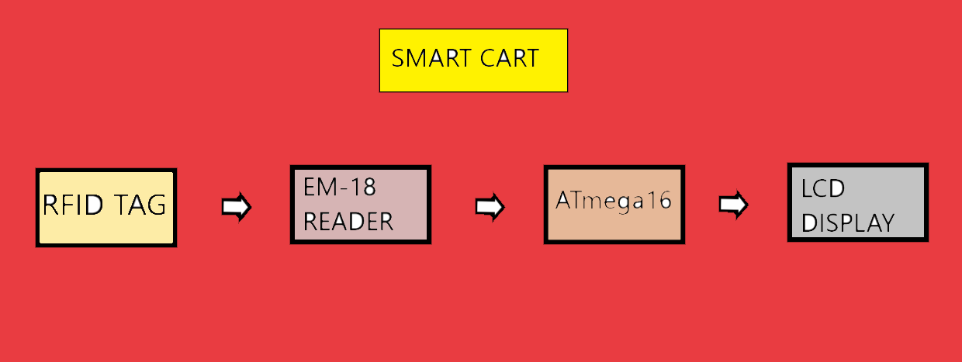
DETAILED TECHNICAL SPECIFICATIONS AND PICTORIAL REPRESENTATIONS (BLOCK DIAGRAMS/ FLOW CHART):

Slide 11
RFID TAG
RFID tagging uses small radio frequency identification devices to track and identify objects. An RFID tagging system includes the tag itself, also known as a transponder; a scanning antenna and receiver, often combined into one reader, also known as an interrogator; and a host system application for data collection, processing and transmission.
ATmega16
ATmega16 is an 8-bit high performance microcontroller of Atmel’s Mega AVR family with low power consumption.
Atmega16 is based on enhanced RISC architecture with 131 powerful instructions. Most of the instructions execute in one machine cycle. Atmega16 can work on a maximum frequency of 16MHz.
RFID READER
A radio frequency identification reader (RFID reader) is a device used to gather information from an RFID tag, which is used to track individual objects. Radio waves are used to transfer data from the tag to a reader.
LCD DISPLAY
LCD (liquid crystal display) is the technology used for displays in notebook and other smaller computers. Like light-emitting diode (LED) and gas-plasma technologies, LCDs allow displays to be much thinner than cathode ray tube (CRT) technology.

Slide 12

DESCRIPTION OF THE FLOW OF OPERATIONS:
THE SECOND PART OF THIS PROJECT IS THE SMART CART. WE HAVE RFID TAGS CONNECTED TO ALL THE ITEMS. IN THIS, WHEN ANY ITEM IS ADDED TO THE CART,THEN THE EM-18 READER CONNECTED TO IT DETECTS THE ITEM AND SENDS THE DATA TO ATMEGA 16. THE ATMEGA BOARD PROCESSES THE DATA AND PRINTS THE BILL ON THE LCD.

Slide 13
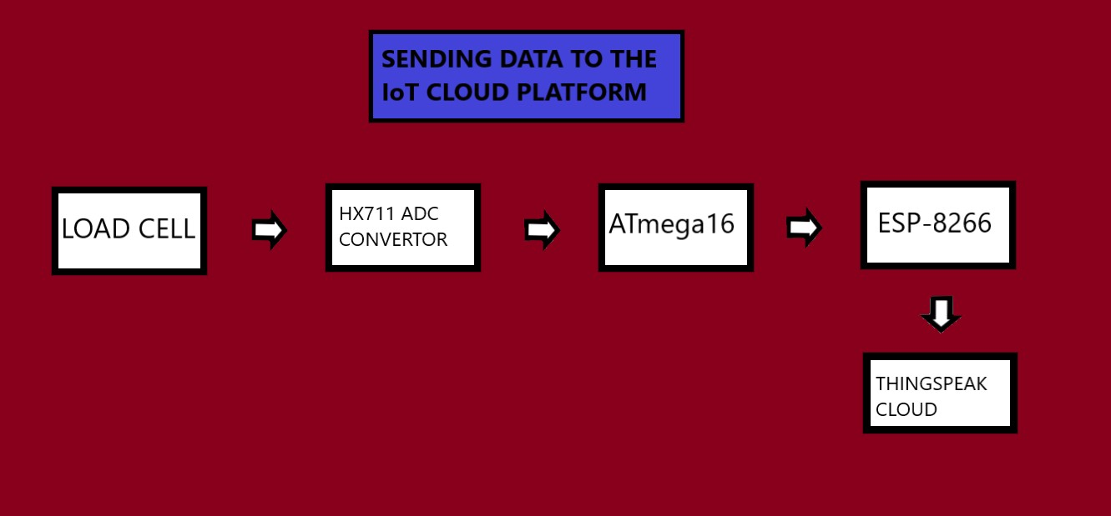

Slide 14
LOAD CELL
ESP-8266
The ESP8266 is a low-cost Wi- Fi microchip with full TCP/IP stack and microcontroller capability produced by Shanghai-based Chinese manufacturer Espressif Systems.
The chip first came to the attention of western makers in August 2014 with the ESP-01 module, made by a third-party manufacturer Ai-Thinker.
THINGSPEAK
ThingSpeak is an open-source Internet of Things (IoT) application and API to store and retrieve data from things using the HTTP protocol over the Internet or via a Local Area Network. ThingSpeak enables the creation of sensor logging applications, location tracking applications, and a social network of things with status updates
A load cell is a transducer that is used to create an electrical signal whose magnitude is directly proportional to the force being measured. The various load cell types include hydraulic, pneumatic, and strain gauge.
HX711
This module uses 24 high precision A/D converter chip HX711. It is a specially designed for the high precision electronic scale design, with two analog input channel, the internal integration of 128 times the programmable gain amplifier.

Slide 15
DESCRIPTION OF THE FLOW OF OPERATIONS:
FIRST OF ALL THE WEIGHT SENSORS DETECT THE WEIGHT OF THE SHELF AND SEND AN ANALOG VALUE TO THE HX711 MODULE, WHICH DIGITIZES THE VALUE AND THEN PASSES IT THE DATA TO THE ATMEGA 16 BOARD. NOW THE ATMEGA BOARD SENDS THE SIGNAL TO THE ESP MODULE WHICH THEN UPLOADS IT TO THE CLOUD, THEREBY SUGGESTING ABOUT THE MOVEMENT OF THE ITEM.

Slide 16
PERFORMANCE ESTIMATE OF THE SOLUTION:
T H E S O L U T I O N P R O V I D E D B Y O U R T E A M D E A L S W I T H T H E T O P I C O F R E T A I L
I N D U S T R Y . I N O U R P R O J E C T , W E A R E T R Y I N G T O K E E P T R A C K O F I T E M S
U S I N G T H E R F I D T A G S A N D T H E W E I G H T S E N S O R S . T H I S W O U L D H E L P U S I N T W O W A Y S , F I R S T L Y I T W O U L D T E L L U S
T H A T A N I T E M H A S B E E N A D D E D T O T H E C A R T A N D S E C O N D L Y I T W O U L D
A U T O M A T I C A L L Y P R I N T T H E B I L L T H A T
T H E | C U S T O M E R | H A S | T O | P A Y | O N | T H E
L C D | S C R E E N .

Slide 17
THE USAGE OF WEIGHT SENSORS IS NOT THAT EFFICIENT, AS IT WOULD NOT TELL US THE TYPE OF ITEM BEING REMOVED. WE COULD HAVE USED RFID TAGS IN THEIR PLACE, BUT IT WOULD NOT BE COST EFFICIENT. ALTHOUGH WE CAN SOLVE THE ABOVE PROBLEM BY CREATING A SEPARATE SHELF FOR DIFFERENT TYPE OF ITEMS. IT WOULD ALSO BE HELPFUL AS WHEN THE WEIGHT OF ANY SHELF GOES BELOW A PARTICULAR VALUE, IT WOULD PROMPT THE SHOPKEEPER TO RESTOCK THAT ITEM. SO, MORE OR LESS THIS PROJECT WOULD BRING A HUGE CHANGE IN THE RETAIL INDUSTRY.

Slide 18
EXPERIMENTATION DONE TO ESTABLISH THE WORKABILITY OF THE PROTOTYPE:
WE HAVE DESIGNED A CARDBOARD PAPER SHELF SO THAT WE CAN WASILY PUT WEIGHT ON IT.
WE HAVE USED 5 RFID TAGS FOR THE COMPLETE TESTING OF OUR SMART CART.
WE HAVE POWERED UP THE ESP MODULE THROUGH USB TO TTL CONVERTER AT 3.3V.
WE ARE USING HX711 TO CONVERT THE ANALOG SIGNAL TO DIGITAL SIGNAL.

Slide 19
LINK TO THE VIDEO OF THE WORKING PROTOTYPE: HTTPS://YOUTU.BE/R5QCN7UCP5S

Slide 20

THANK YOU

